Slide 1
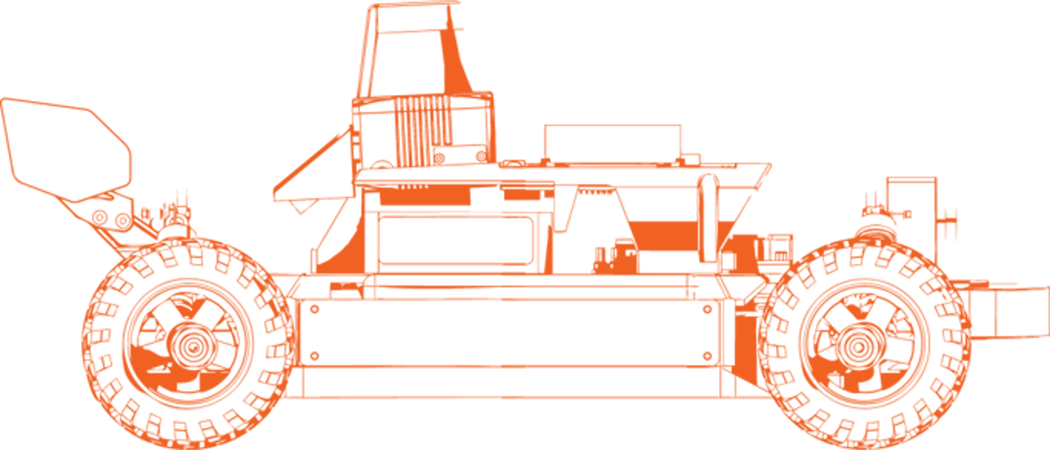
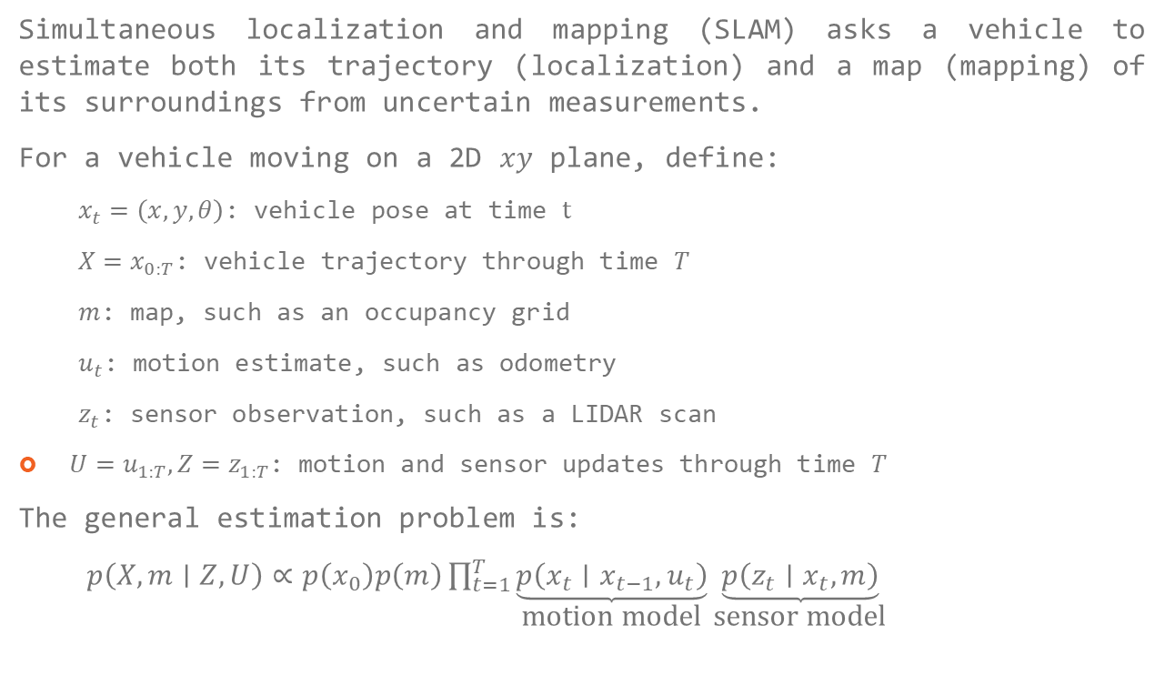
Mapping
Simultaneous localization and mapping (SLAM) asks a vehicle to estimate both its trajectory (localization) and a map (mapping) of its surroundings from uncertain measurements.
For a vehicle moving on a 2D $xy$ plane, define:
  $x_{t}=\left(x,y,θ\right)$: vehicle pose at time $t$
  $X=x_{0:T}$: vehicle trajectory through time $T$
  $m$: map, such as an occupancy grid
  $u_{t}$: motion estimate, such as odometry
  $z_{t}$: sensor observation, such as a LIDAR scan
$U=u_{1:T}, Z=z_{1:T}$: motion and sensor updates through time $T$
The general estimation problem is:
$p\left(X,m∣Z,U\right)∝p\left(x_{0}\right)p\left(m\right)\prod_{t=1}^{T}{\underset{\text{motion model}}{\underbrace{p\left(x_{t}∣x_{t−1},u_{t}\right)}}}\underset{\text{sensor model}}{\underbrace{p\left(z_{t}∣x_{t},m\right)}}$
The motion model describes how odometry constrains consecutive poses. The sensor model describes how well a pose and map explain an observation. Because motion and measurements are uncertain, the goal is to find an estimate that reconciles them.
Recognizing a previously visited place/pose supplies a loop closure that can reduce drift.

Slide 2
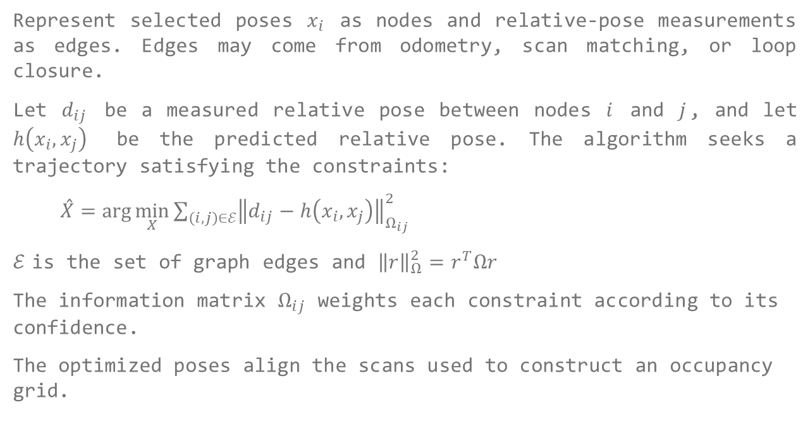
Graph-SLAM
Represent selected poses $x_{i}$ as nodes and relative-pose measurements as edges. Edges may come from odometry, scan matching, or loop closure.
Let $d_{ij}$ be a measured relative pose between nodes $i$ and $j$, and let $h\left(x_{i},x_{j}\right)$ be the predicted relative pose. The algorithm seeks a trajectory satisfying the constraints:
$\overset{ˆ}{X}=\arg{\min_{X}{\sum_{\left(i,j\right)∈ℰ}{{\left\|d_{ij}−h\left(x_{i},x_{j}\right)\right\|}_{Ω_{ij}}^{2}}}}$
$ℰ$ is the set of graph edges and ${\left\|r\right\|}_{Ω}^{2}=r^{T}Ωr$
The information matrix $Ω_{ij}$ weights each constraint according to its confidence.
The optimized poses align the scans used to construct an occupancy grid.
Core idea: find a single trajectory estimate that best reconciles a graph of relative-pose constraints.

Slide 3
GMapping
Represent selected poses $x_{i}$ as nodes and relative-pose measurements as edges. Edges may come from odometry, scan matching, or loop closure.
Let $d_{ij}$ be a measured relative pose between nodes $i$ and $j$, and let $h\left(x_{i},x_{j}\right)$ be the predicted relative pose. The algorithm seeks a trajectory satisfying the constraints:
$\overset{ˆ}{X}=\arg{\min_{X}{\sum_{\left(i,j\right)∈ℰ}{{\left\|d_{ij}−h\left(x_{i},x_{j}\right)\right\|}_{Ω_{ij}}^{2}}}}$
$ℰ$ is the set of graph edges and ${\left\|r\right\|}_{Ω}^{2}=r^{T}Ωr$
The information matrix $Ω_{ij}$ weights each constraint according to its confidence.
The optimized poses align the scans used to construct an occupancy grid.
Core idea: approximate trajectory uncertainty with multiple possible paths, each paired with a map.

Slide 4
Cartographer
Represent selected poses $x_{i}$ as nodes and relative-pose measurements as edges. Edges may come from odometry, scan matching, or loop closure.
Let $d_{ij}$ be a measured relative pose between nodes $i$ and $j$, and let $h\left(x_{i},x_{j}\right)$ be the predicted relative pose. The algorithm seeks a trajectory satisfying the constraints:
$\overset{ˆ}{X}=\arg{\min_{X}{\sum_{\left(i,j\right)∈ℰ}{{\left\|d_{ij}−h\left(x_{i},x_{j}\right)\right\|}_{Ω_{ij}}^{2}}}}$
$ℰ$ is the set of graph edges and ${\left\|r\right\|}_{Ω}^{2}=r^{T}Ωr$
The information matrix $Ω_{ij}$ weights each constraint according to its confidence.
The optimized poses align the scans used to construct an occupancy grid.
Core idea: build locally consistent submaps, then align trajectory nodes and submaps globally.

Slide 5
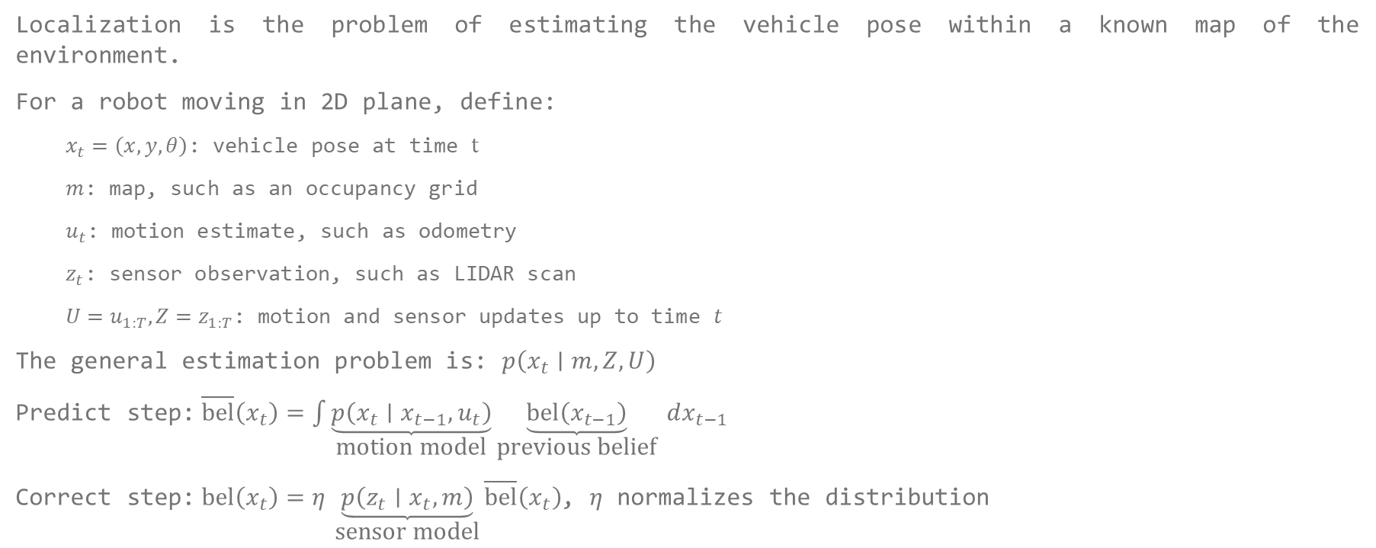
Localization
Localization is the problem of estimating the vehicle pose within a known map of the environment.
For a robot moving in 2D plane, define:
  $x_{t}=\left(x,y,θ\right)$: vehicle pose at time $t$
  $m$: map, such as an occupancy grid
  $u_{t}$: motion estimate, such as odometry
  $z_{t}$: sensor observation, such as LIDAR scan
  $U=u_{1:T}, Z=z_{1:T}$: motion and sensor updates up to time $t$
The general estimation problem is: $p\left(x_{t}∣m, Z,U\right)$
Predict step: $\overline{bel}\left(x_{t}\right)=\int{\underset{\text{motion model}}{\underbrace{p\left(x_{t}∣x_{t−1},u_{t}\right)}}}\underset{\text{previous belief}}{\underbrace{\operatorname{bel}\left(x_{t−1}\right)}} dx_{t−1}$
Correct step: $\operatorname{bel}\left(x_{t}\right)=η \underset{\text{sensor model}}{\underbrace{p\left(z_{t}∣x_{t},m\right)}}\overline{bel}\left(x_{t}\right)$, $η$ normalizes the distribution
Predict: Use the motion model to estimate where the robot may have moved.
Correct: Compare the new sensor observation with the map to favor poses that better explain what the robot sees.

